Slide 1

Software Quality Engineering
BSSE-VI
Dr. Sumaira Nazir
Assistant Professor
Department of Software Engineering
National University of Modern Languages, Islamabad

Slide 2
Product Standards
ISO 9126 Standard Quality Model
Goal-Question-Metric Model

Slide 3
ISO 9126 Standard Quality Model

Slide 4
ISO 9126 Standard Quality Model
The ISO 9126 software quality model identifies 6 main quality characteristics, namely:
Functionality
Reliability
Usability
Efficiency
Maintainability
Portability

Slide 5
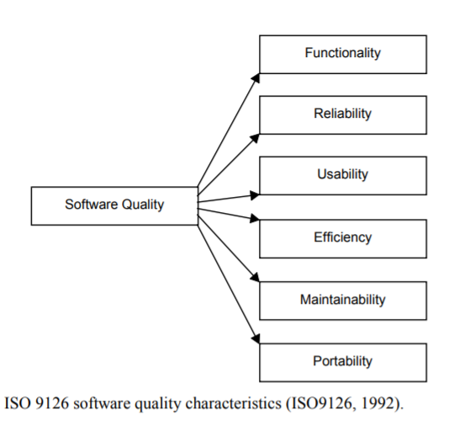

Slide 6
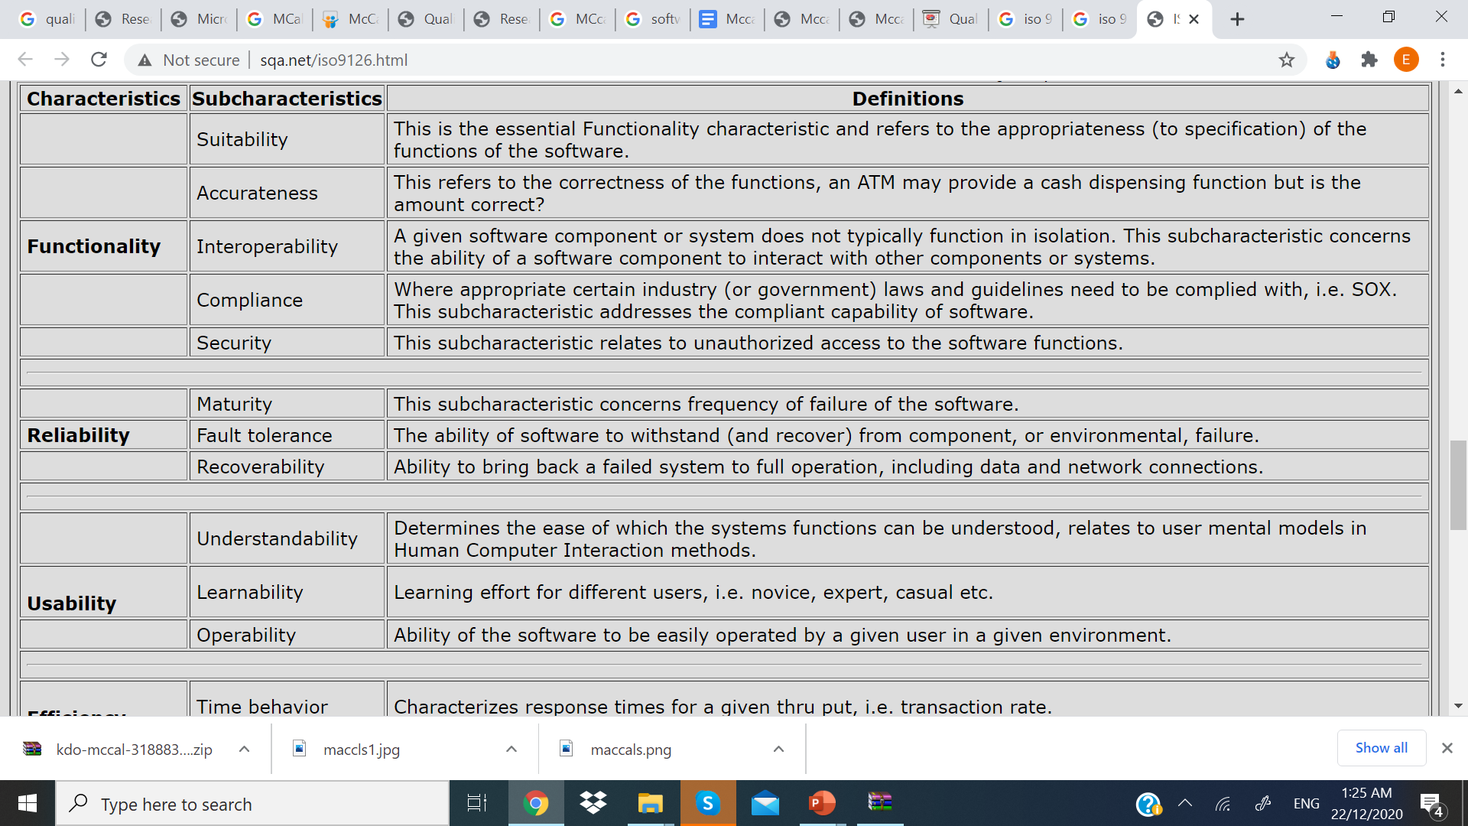
ISO 9126 Standard Quality Model
These characteristics are broken down into sub-characteristics.

Slide 7
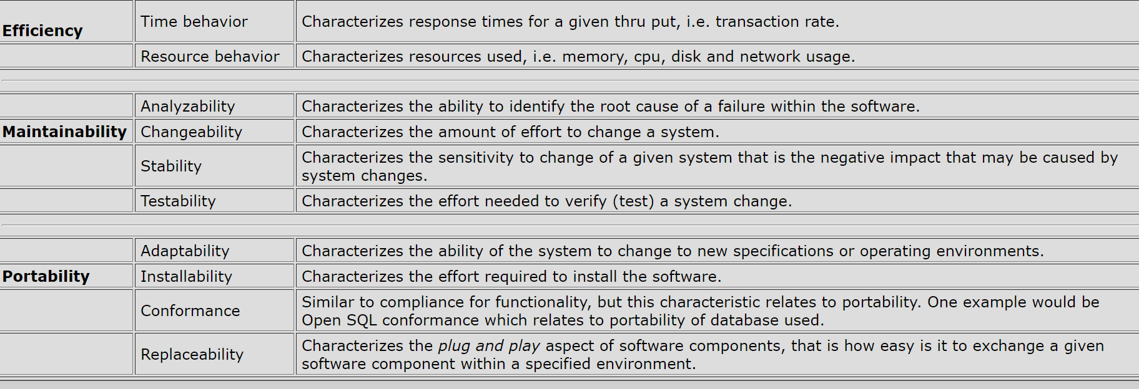
ISO 9126 Standard Quality Model

